Slide 1
Advanced Fraud Tools

Slide 2
Prevent online payment fraud before it happens at your hotel

Slide 3
The Current Challenge
Fraudsters are committing online payment fraud through third-party bookings and same-day bookings. The fraudster will book a room using a stolen credit card, stay at the hotel, and check out before the cardholder is even aware that their card number has been stolen. Once the card has been charged, that’s when the cardholder realizes that their number has been compromised. This leads to requesting a chargeback, which ultimately impacts the hotel’s bottom line.

Slide 4
Help detect potential fraud before it leads to chargebacks
How Does
It Help
Improve your hotel’s bottom line
Preserve your hotel’s reputation
Increase operational efficiency
Enhance existing fraud prevention methods

Slide 5
How Sertifi Advanced Fraud Tools Works
1
2
3
4
Data Assessed on the Back End
User Fills Out Credit Card Authorization Form
Fraud Score
Displayed
You Decide
How to Proceed
Advanced Fraud Tools begin assessing data when the user is filling out the authorization form.
Data points are assessed to determine if a transaction has potential signs of fraud.
Sertifi provides a risk analysis score (A-F) based on different variables.
After a risk analysis score is displayed, you can decide whether to proceed with transaction.

Slide 6
What Data is Being Assessed
Billing Address
Card Details
IP Address
Physical Address
User Device
Payment Type (such as the credit card)
Email
Name
Authorization Status (approved/not approved)
Country/Currency
Payment Token
Last 4 digits of card number
And much more

Slide 7
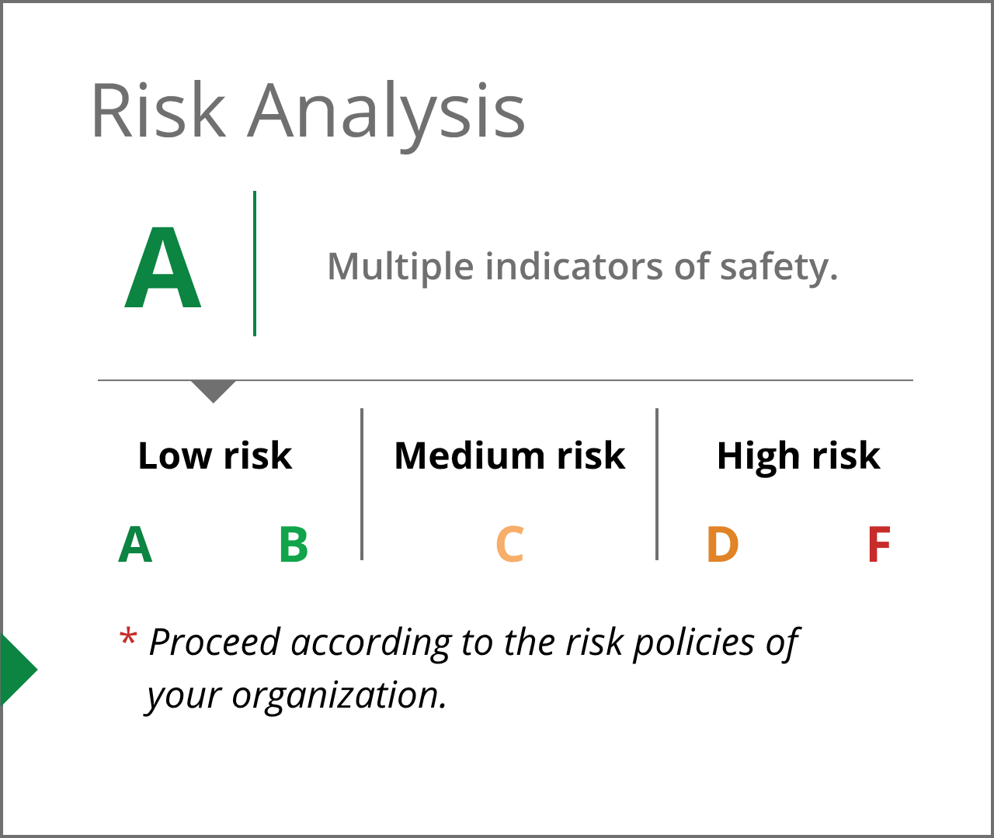
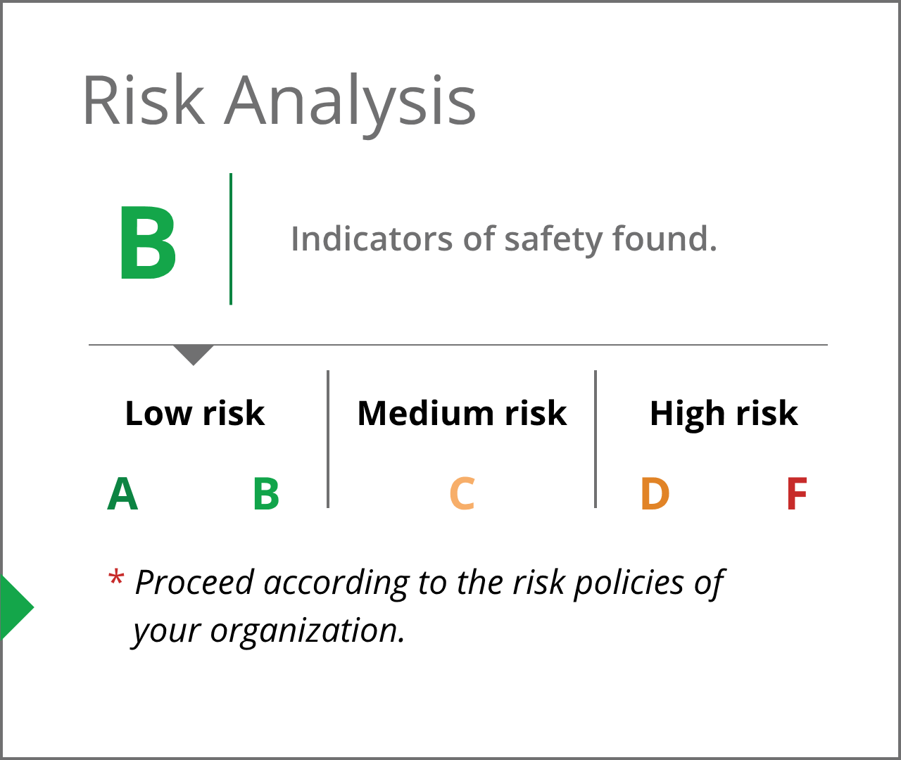
Risk Analysis Scores - Low Risk
If the risk analysis score is an A or B, it contains numerous indicators of safety.
Always check your organization’s policies regarding payment fraud.

Slide 8
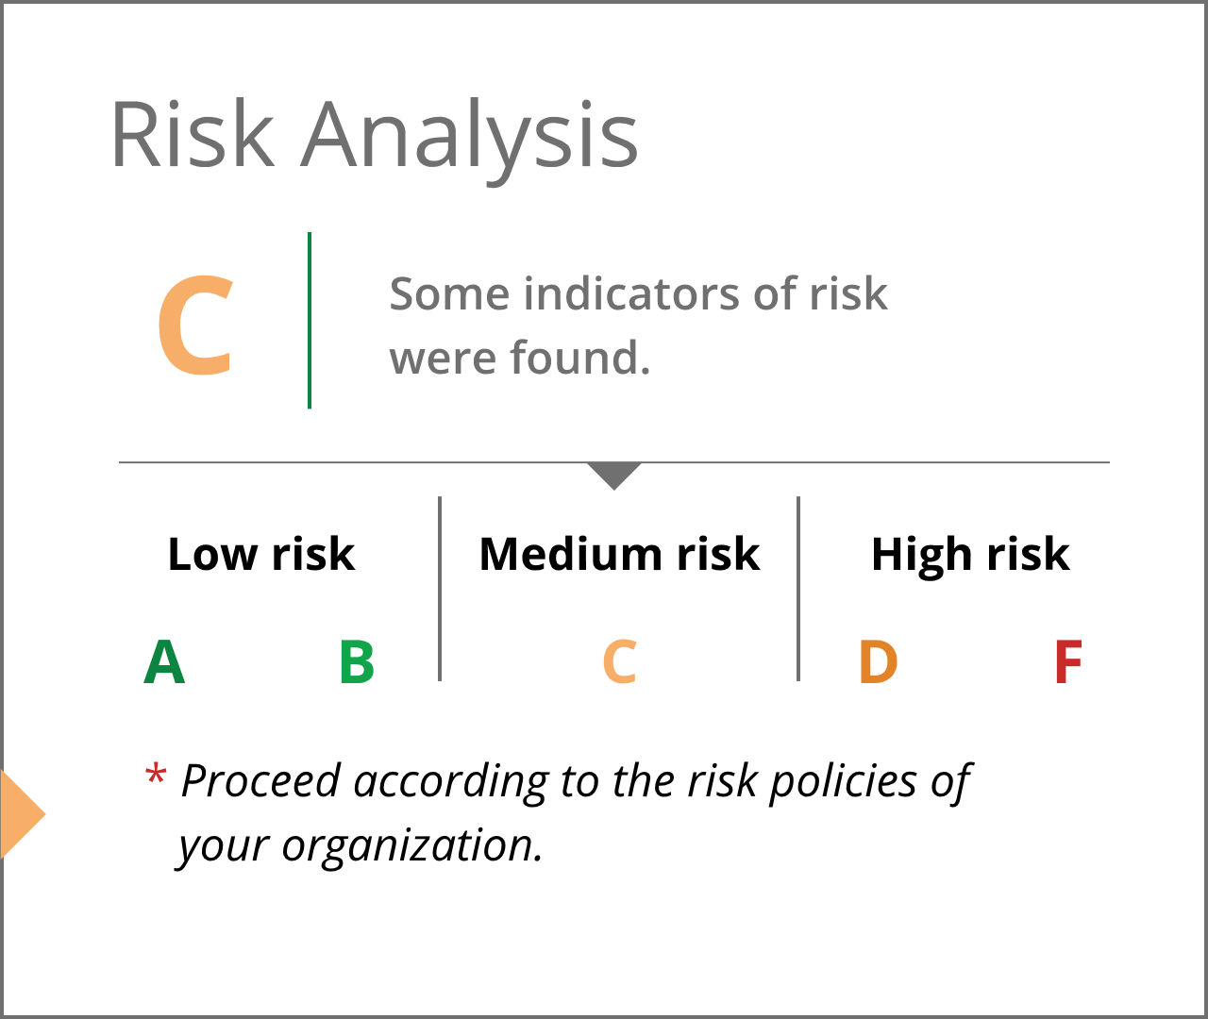
Risk Analysis Score - Medium Risk
If the risk analysis score is a C, some risks were found.
Always check your organization’s policies regarding payment fraud.

Slide 9
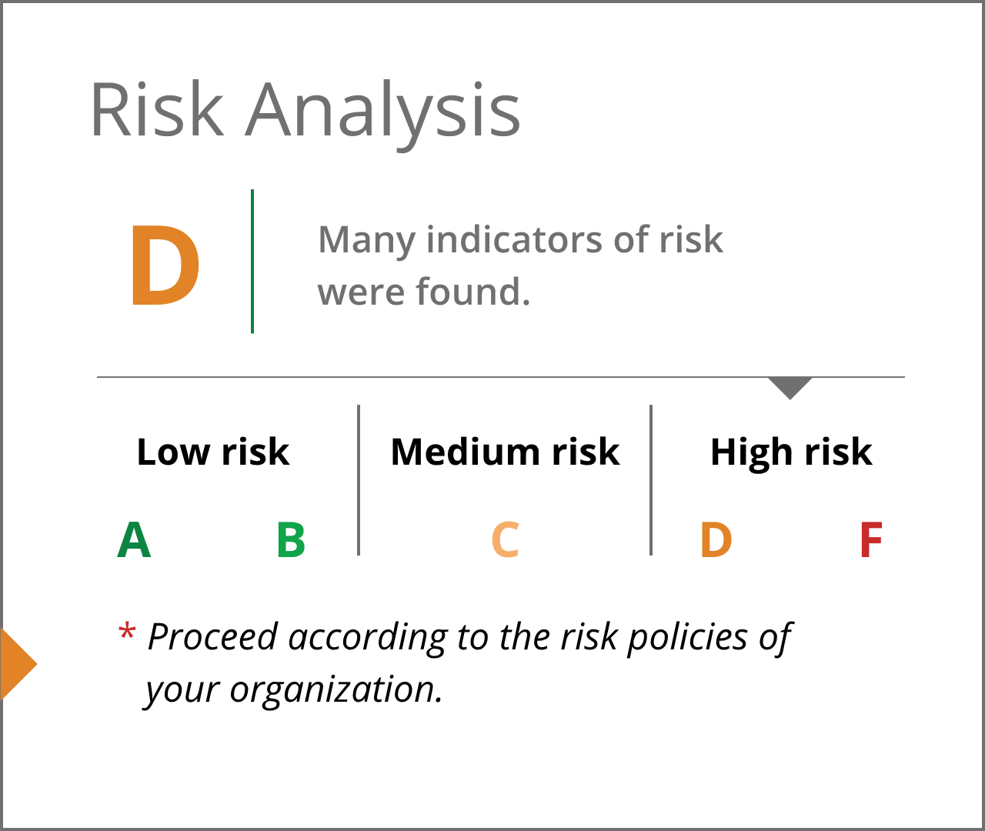
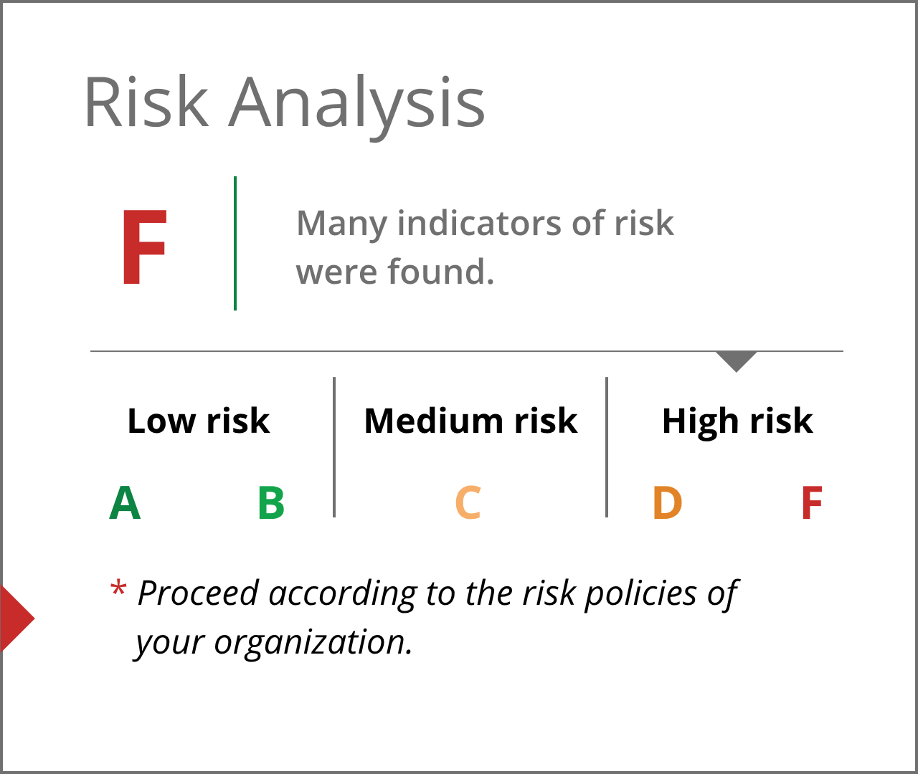
Risk Analysis Scores - High Risk
Transactions with a D or F rating have one or more serious signs of risk.
Always check your organization’s policies regarding payment fraud.

